Slide 1
Fundamental Observations
Observations that led to the current standard model of the Universe (Hot Big Bang Model):
Dark night sky
Large scale isotropy and homogeneity of universe
Redshift and distance relation
Astro-particles
CMB

Slide 2
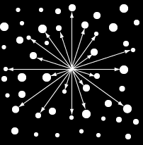
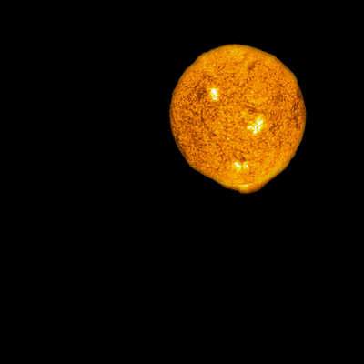
1. Olbers’ Paradox- the night sky is dark
In a static, infinitely old and infinitely large universe with an infinite number of stars, space would be bright rather than dark.
Under certain simplifying assumptions, like all stars being identical to the Sun, the sky should be uniformly bright

Slide 3
Assumptions/Resolutions
Space is transparent everywhere
Universe is infinitely large
Universe is infinitely old (Primary resolution. What about redshift?)
Surface brightness of stars is independent of distance

Slide 4
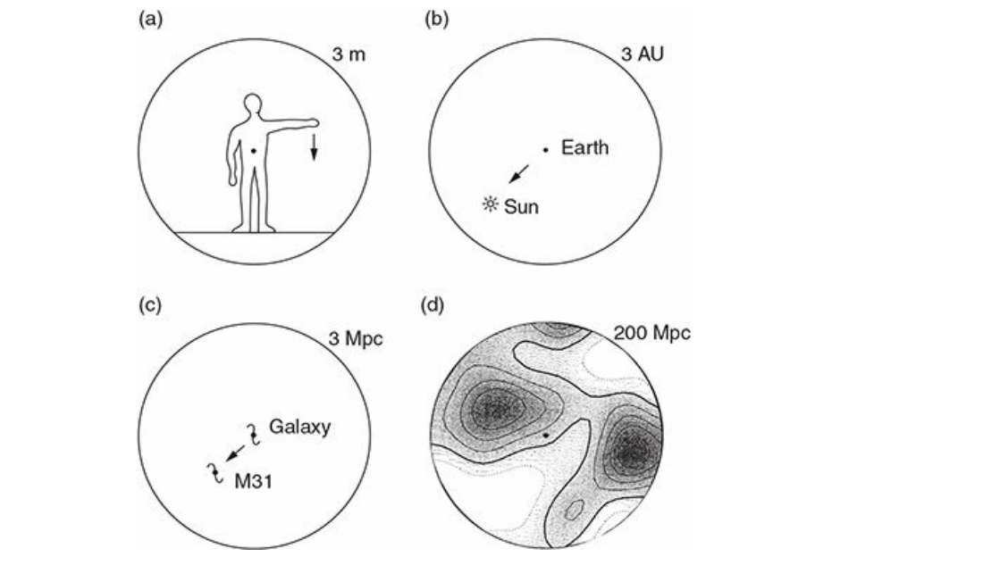
2. The Universe is Isotropic and Homogeneous
This is true only on very large scales, usually of the order of 100 Mpc or more

Slide 5
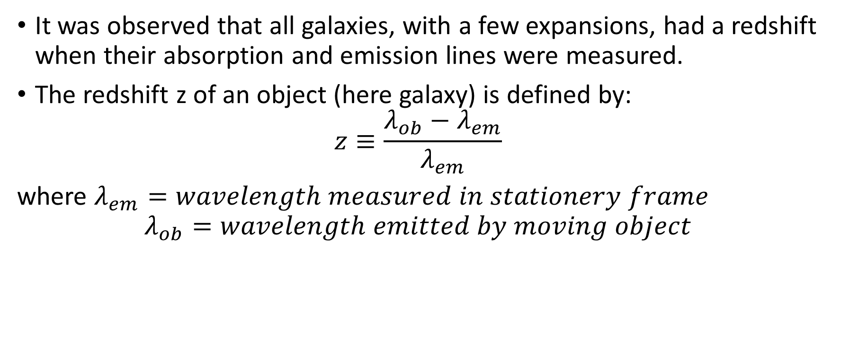
Redshift
It was observed that all galaxies, with a few expansions, had a redshift when their absorption and emission lines were measured.
The redshift z of an object (here galaxy) is defined by:
$$z≡\frac{λ_{ob}−λ_{em}}{λ_{em}}$$
where $λ_{em}=wavelength measured in stationery frame$
$$λ_{ob}=wavelength emitted by moving object$$

Slide 6
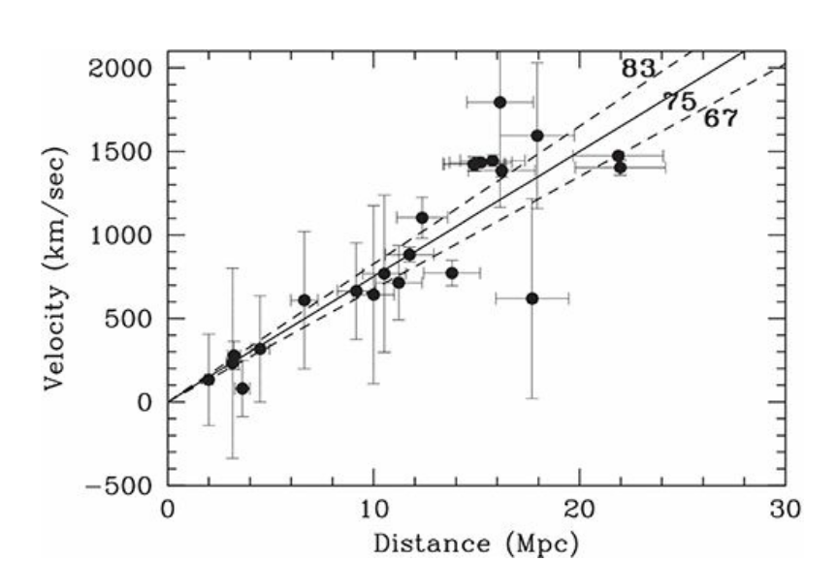
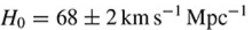
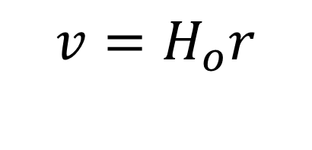
Hubble Expansion
$$v=H_{o}r$$

Slide 7
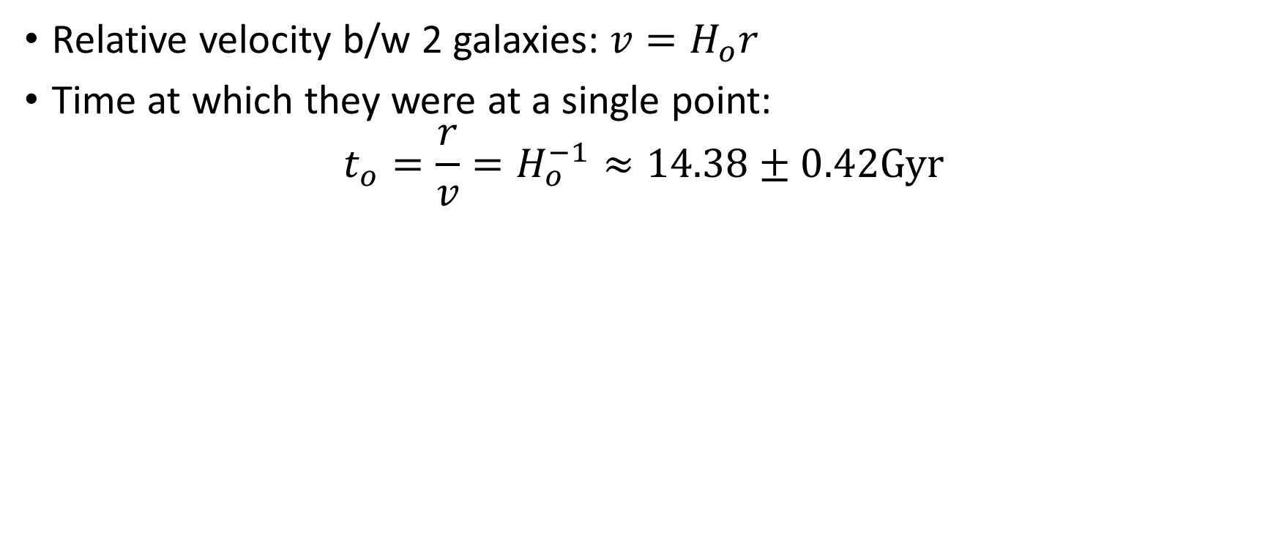
Hubble Time
Relative velocity b/w 2 galaxies: $v=H_{o}r$
Time at which they were at a single point:
$$t_{o}=\frac{r}{v}=H_{o}^{−1}≈14.38±0.42Gyr$$

Slide 8
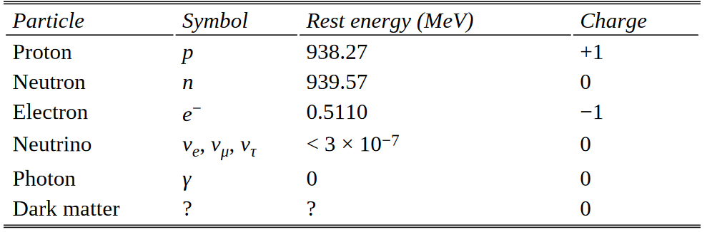
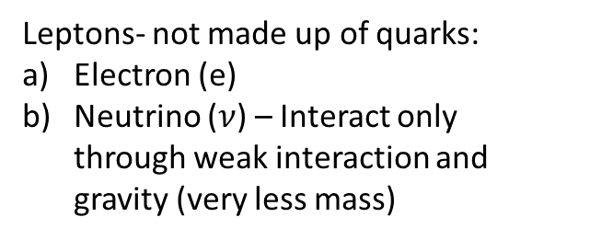
Different types of particles
Baryons- Made up of 3 quarks:
Proton (p) – 2 up, 1 down
Neutron (n) – 1 up, 2 down
Up quarks have charge of +2/3 e
Down quarks have charge of -1/3 e
Leptons- not made up of quarks:
Electron (e)
Neutrino ($ν$) – Interact only through weak interaction and gravity (very less mass)

Slide 9
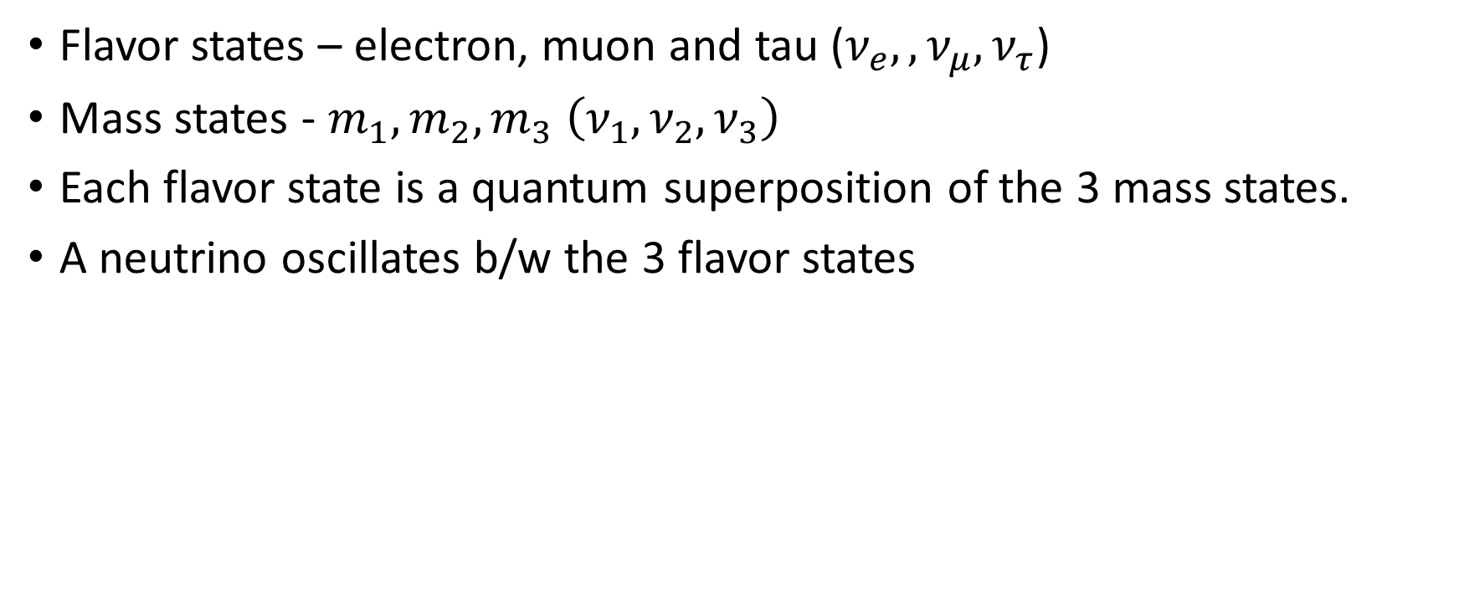
Neutrinos
Flavor states – electron, muon and tau ($ν_{e},{,ν_{μ},ν}_{τ}$)
Mass states - $m_{1},m_{2},m_{3} \left(ν_{1},ν_{2},ν_{3}\right)$
Each flavor state is a quantum superposition of the 3 mass states.
A neutrino oscillates b/w the 3 flavor states

Slide 10
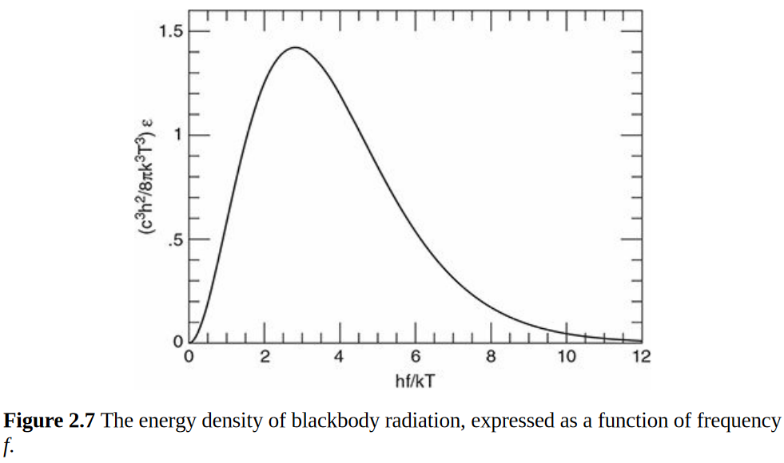
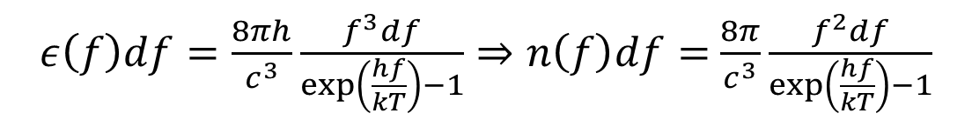
Blackbody radiation
$ε\left(f\right)df=\frac{8πh}{c^{3}}\frac{f^{3}df}{\exp\left(\frac{hf}{kT}\right)−1}⇒n\left(f\right)df=$ $\frac{8π}{c^{3}}\frac{f^{2}df}{\exp\left(\frac{hf}{kT}\right)−1}$

Slide 11
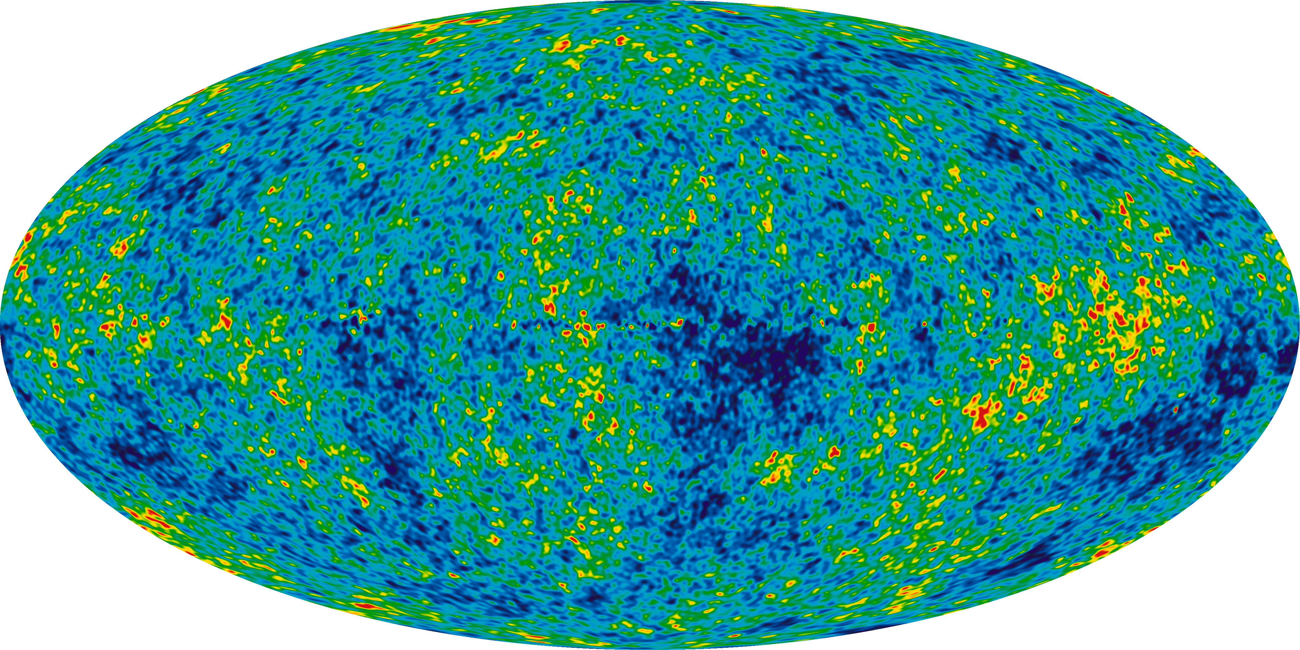
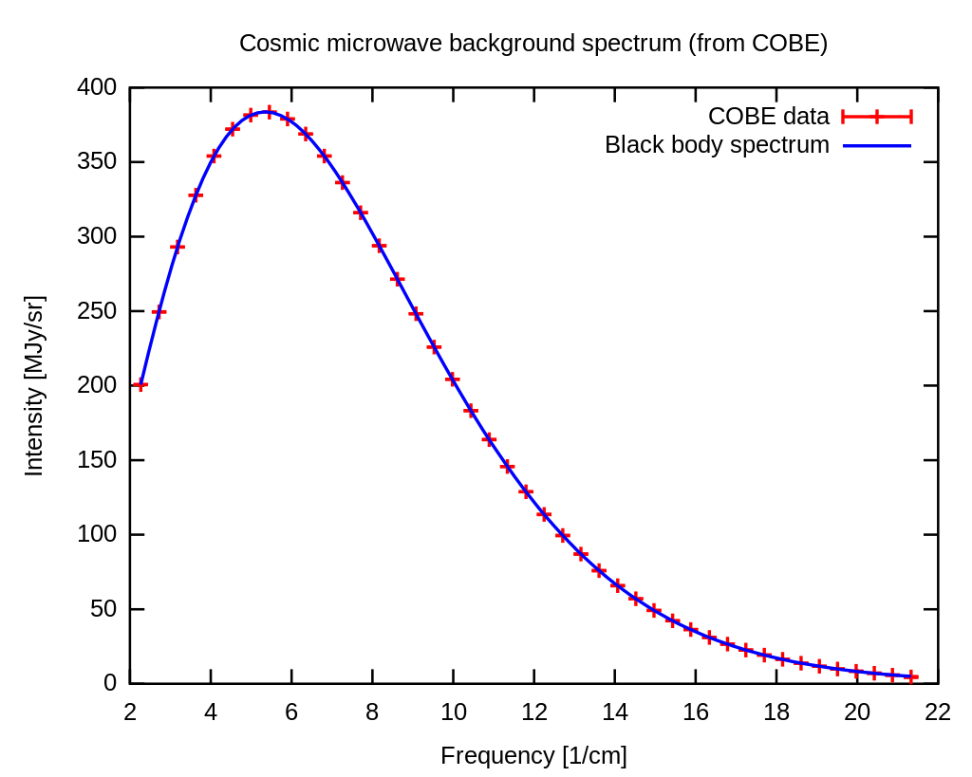
Cosmic Microwave Background (CMB)
The universe is filled with microwave radiation that is (almost isotropic).
Overlap with theoretical blackbody spectrum of T=2.72 K

Slide 12
4 fundamental forces
In increasing order of magnitude:
Gravity
Dominant force over cosmological scales
Electromagnetism
Also acts over huge length scales, but Universe is neutral over large scales
Weak Interaction (10⁻¹⁸m)
Strong Interaction (10⁻¹⁵m)

Slide 13
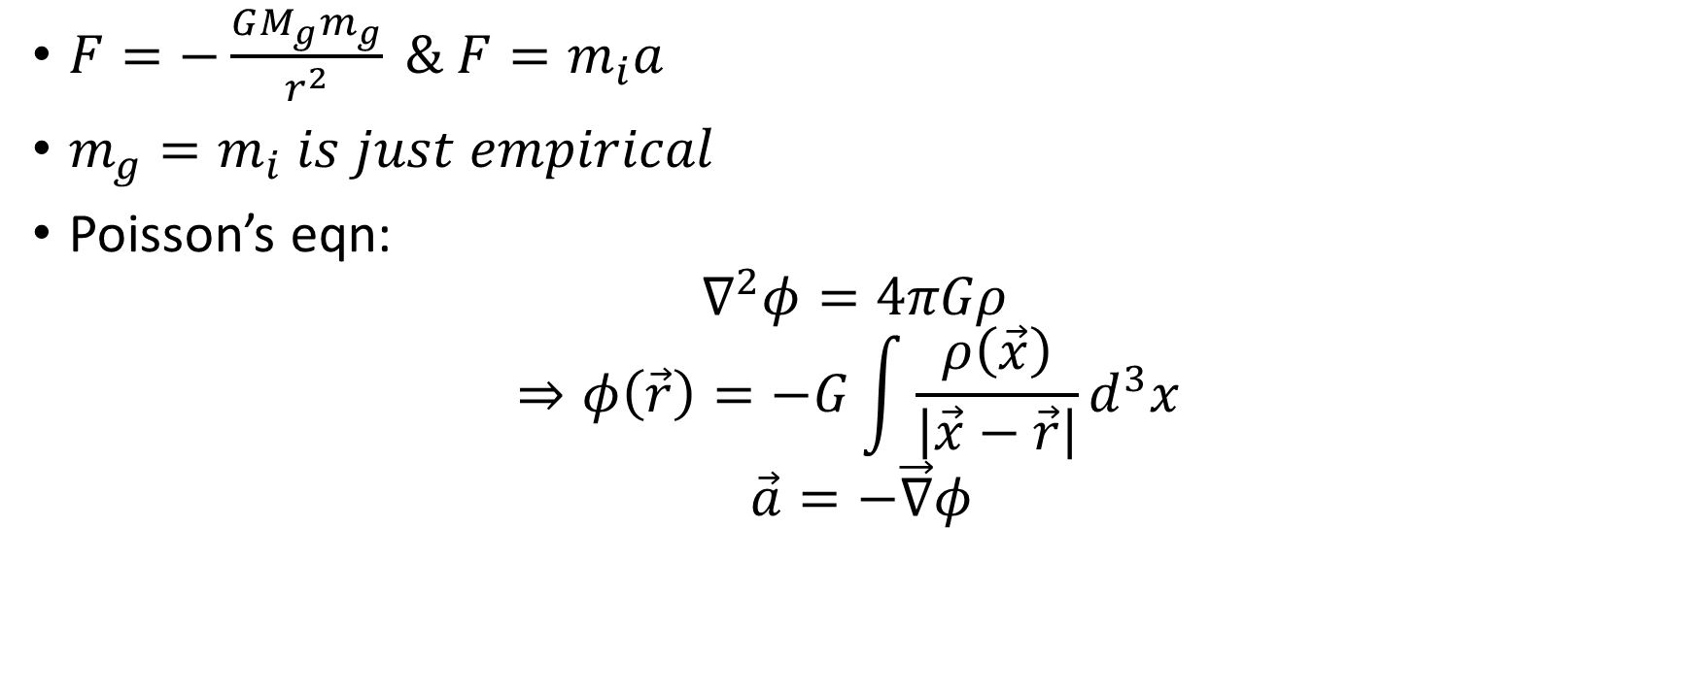
Newtonian description of Gravity
$F=−\frac{GM_{g}m_{g}}{r^{2}} \& F=m_{i}a$
$m_{g}=m_{i} is just empirical$
Poisson’s eqn:
$$∇^{2}φ=4πGρ$$
$$⇒φ\left(\vec{r}\right)=−G\int{\frac{ρ\left(\vec{x}\right)}{\left|\vec{x}−\vec{r}\right|}d^{3}x}$$
$$\vec{a}=−\vec{∇}φ$$

Slide 14
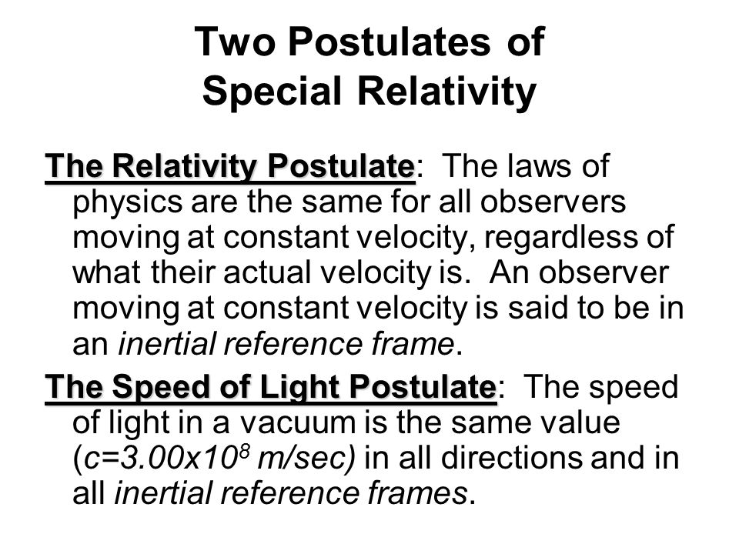
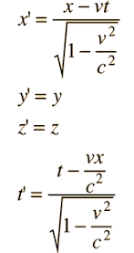
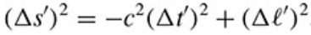
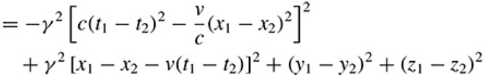
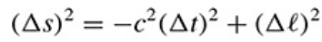
Special Relativity and the Lorenz Transformation

Slide 15
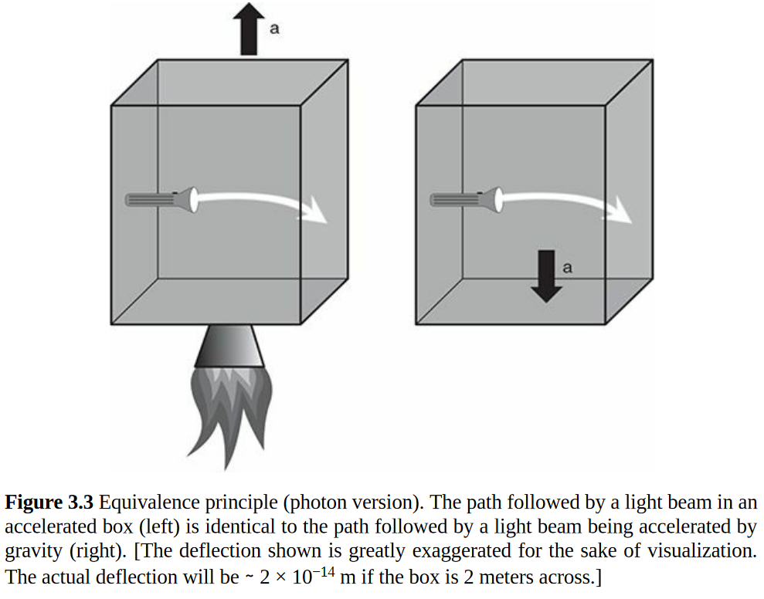

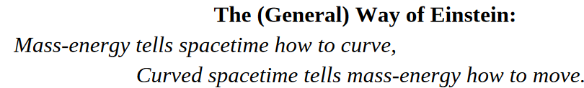
GR and Equivalence Principle

Slide 16
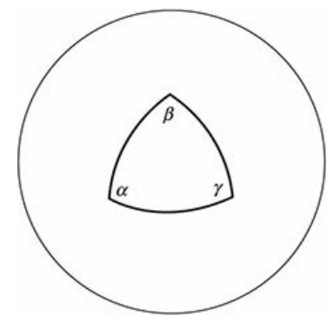
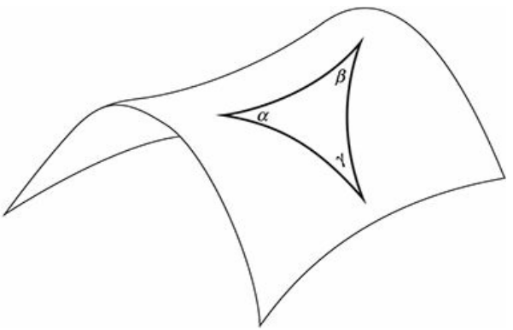
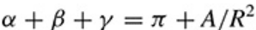
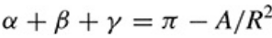
Curvature
If curvature is positive
α + β + γ > π
If curvature is negative
α + β + γ < π
For Uniform Positive Curvature
For Uniform Negative Curvature

Slide 17
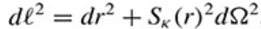
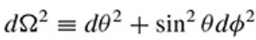
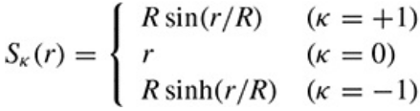
Metrics: gives distance between two nearby points
If space is homogeneous and isotropic, 3 possibilities:
Flat (k=0):
Uniform Positive (k=1):
Uniform Negative (k=-1):

Slide 18
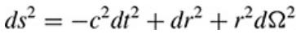
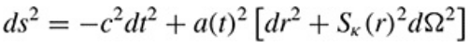
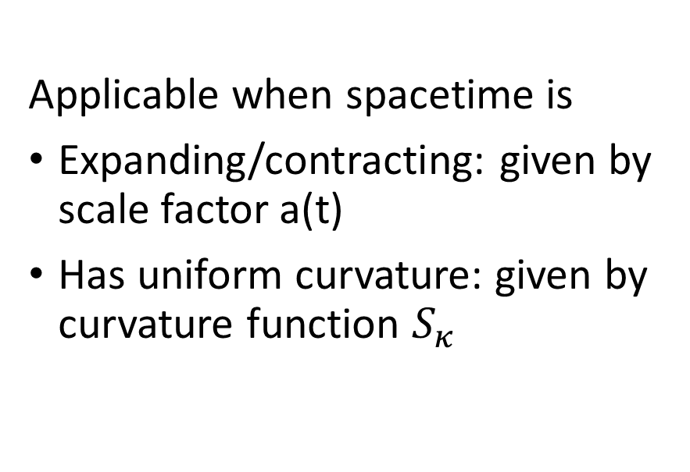
Metrics for 4-D Spacetime
Minkowski Metric
Robertson-Walker Metric
Applicable only for Minkowski spacetime, which is
Static
Euclidian
Applicable when spacetime is
Expanding/contracting: given by scale factor a(t)
Has uniform curvature: given by curvature function $S_{κ}$

Slide 19
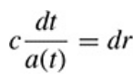
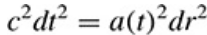
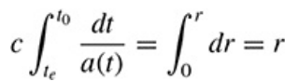
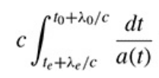
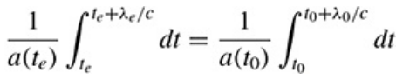
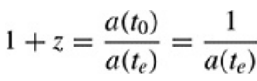

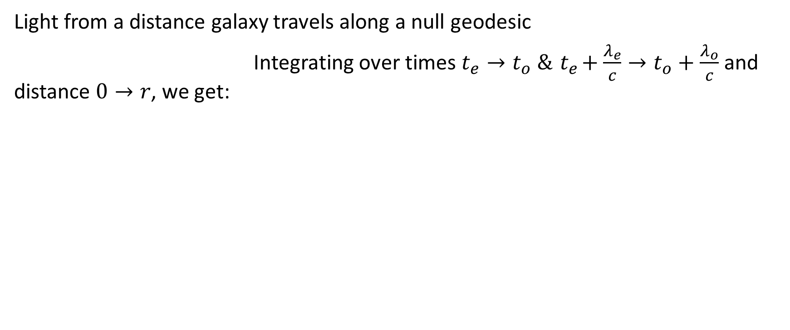

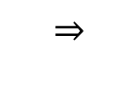
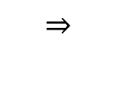
Relation between redshift(z) and the scale factor(a)
Light from a distance galaxy travels along a null geodesic
Integrating over times $t_{e}→t_{o} \&{ t}_{e}+\frac{λ_{e}}{c}→t_{o}+\frac{λ_{o}}{c}$ and distance $0→r$, we get:
$$∴$$
$$⇒$$
$$⇒$$
$$∴$$

Slide 20
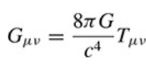
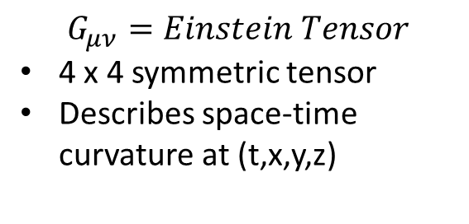
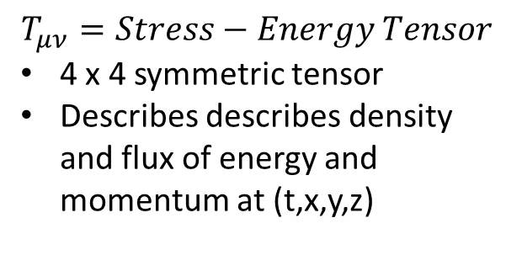
Einstein’s (original) Field Equation
$$G_{μν}=Einstein Tensor$$
4 x 4 symmetric tensor
Describes space-time curvature at (t,x,y,z)
$$T_{μν}=Stress−Energy Tensor$$
4 x 4 symmetric tensor
Describes describes density and flux of energy and momentum at (t,x,y,z)
Due to symmetry of both tensors, the equation provides 10 nonlinear 2nd order DEs. The nature of the solutions can be analyzed to predict properties of space-time. Also yields propagating wave solutions.

Slide 21
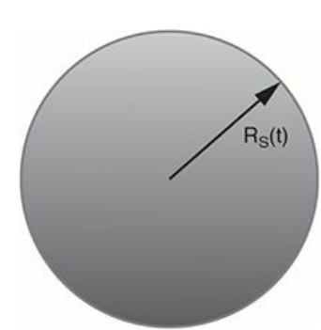
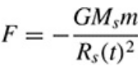
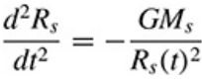
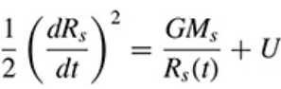
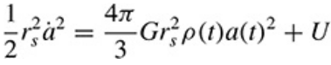







Friedmann Equation
Equation that links the Universe’s parameters of curvature [a(t), $κ, R_{o}$] to its parameters of content [$ε\left(t\right), P\left(t\right)$]
Parameters are functions of only time because Universe contains homogeneous and isotropic perfect gas
Non-relativistic/Newtonian version:
${\left(\frac{\dot{a}}{a}\right)}^{2}=\frac{8πG}{3}ρ\left(t\right)+\frac{2U}{r_{s}^{2}}\frac{1}{a{\left(t\right)}^{2}}$
Where $r_{s}=comoving radius of sphere$
$$⇒$$
$$⇒$$
Let $R_{s}\left(t\right)=a\left(t\right)r_{s}$
$$∴$$
$$⇒$$

Slide 22















Friedmann Equation
Relativistic version, derived from Einstein’s original field equation:
We know,
At present, $t=t_{o}∴$
For $κ=0$, critical density &
Density Parameter In terms of $Ω\left(t\right),$ Friedmann Equation:
At present,
$$∴$$
$$\&$$
$$⇒$$

Slide 23






Fluid Equation, Acceleration Equation and Equation of State
First Law of Thermodynamics and dynamics of an expanding Universe gives: (Fluid Equation)
Taking time derivative of Friedmann Eq and combining with above gives: (Acceleration Equation)
Relation between Pressure and Density: $P=wε$
$$⇒$$
$w≈\frac{\left\langle v^{2}\right\rangle }{3c^{2}}≪1$ for nonrel particle (matter)
$w=\frac{1}{3}$ for relativistic particles (radiation)
$w=−1$ for dark energy (cosmo const $Λ$)

Slide 24




The Cosmological Constant $Λ$
Correction term initially added to achieve a static universe conforming to 19th century observations
Corrected Friedmann eq:
Corrected acceleration eq:
Energy density of the additional term: $ε_{Λ}≡\frac{c^{2}}{8πG}Λ$
From fluid eq: $P_{Λ}=−ε_{Λ}=−\frac{c^{2}}{8πG}Λ\left(∵\dot{ε}=0\right)$

Slide 25



Predictions and Problems of $Λ$
Predictions about Einstein’s static universe:
$\ddot{a}=0⇒Λ=4πGρ$
$\dot{a}=0⇒\frac{κc^{2}}{R_{o}^{2}}=$ $4πGρ$
$$∴κ=1$$
$$R_{o}=\frac{c}{Λ^{1/2}}$$
Problems with Einstein’s static universe:
The static model was in unstable equilibrium
The Universe was found to be expanding
The above problems led to $Λ=0$
It was brought back under the assumption that $Λ>4πGρ⇒\ddot{a}>0$
$Λ$ represents a vacuum energy that remains constant irrespective of the dynamics of the universe

Slide 26

















Evolution of Model Universes
Energy density as a function of scale factor (a):
From fluid equation:
$⇒$
Matter (w=0):
Radiation (w=$1/3$):
$Λ$ (w= -1): $ε_{Λ}=ε_{Λ,0}$
Benchmark Model:
$Ω_{r,0}=9∗{10}^{−5};Ω_{m,0}=0.31$
$$Ω_{r,0}≈0.69$$
Friedmann Equation:
$$⇒$$
$$⇒$$
$$⇒$$

Slide 27











Evolution of Single-Component Universes
Equations governing the evolution of the scale factor:
Empty Universe, $k=−1$:
Flat Universe, matter/radiation:
where,
Flat Universe, dark matter:
, where:
$$⇒$$
$$⇒$$

Slide 28









Evolution of Multi-Component Universes
Substituting in Friedmann Equation, we get:
$∵ε\left(t\right)=ε_{m}+ε_{r}+ε_{Λ}=\frac{ε_{m,0}}{a^{3}}+\frac{ε_{r,0}}{a^{4}}+ε_{Λ,0}∴$
$∵H(t)=\dot{\frac{a}{a}}$
$$⇒$$
$$⇒$$

Slide 29






















Matter + Curvature
Matter + Lambda
When $k=+1 (Ω_{o}>1)$:
Universe stops expanding when H(t) = 0
When $k=−1 (Ω_{o}<1)$:
Universe keeps expanding as LHS > 0:
$a∝t^{\frac{2}{3}}$ when $Ω_{m}>Ω_{0}$
$a∝t$ when $Ω_{m}≪Ω_{0}$
$$∵$$
$Ω_{Λ,0}<1$:Universe stops expanding when H(t) = 0
$Ω_{Λ,0}>1$:Universe keeps expanding-
When $a≪a_{mλ}:$
When $a≫a_{mλ}:$

Slide 30




Matter + Curvature + Lambda
Big Bounce: $Ω_{m,0}>0;Ω_{Λ,0}>0; Ω_{m,0}+Ω_{Λ,0}>1$
$$H<0, a≫1$$
Loitering: initial- $a∝t^{\frac{2}{3}};$ int- $a=k;$ final- $a∝e^{kt}$
Big Crunch: can have $k=±1,0$
Big Chill: $k=±1,0;a→∞ as t→∞$

Slide 31



Benchmark Model

Slide 32


Detecting Matter
Info from photodetection:
$Ψ_{V}=1.1×{10}^{8}L_{⊙,V}Mpc^{−3}$
Active Galaxies: M/L_{V} ≈ 0.3 M⊙/ L_{⊙,V}
Quiescent Galaxies: M/L_{V} ≈ 8 M⊙/ L_{⊙,V}
$\left\langle M/{L_{V}}\right\rangle =4.15\frac{M_{⊙}}{L_{⊙,V}}⇒ρ_{∗,0}≈4×{10}^{8}M_{⊙}Mpc^{−3}$
$Ω_{∗,0}≈0.003$ (very low contribution)
Gases measured by observing V-band and x-rays
Info from CMB: temperature fluctuations dependent on photon-baryon ratio of early universe.
Current element composition of universe is dependent on photon-baryon ratio of nascent universe.
$$Ω_{bary,0}≈0.048±0.003$$

Slide 33






Dark Matter
Interacts through gravity and not EM
Existence predicted by observing galaxy rotation.
Keplerian Prediction
Star brightness from centre of galaxy
So $v∝R^{−1/2}$ for $R>R_{s}$

Slide 34















Dark Matter in Galaxy Clusters
Virial Theorem: For a cluster of mass M
&
In steady state: $\ddot{I}=0⇒$ $∴$
Using observational data, $\left\langle v^{2}\right\rangle \& r_{h}$ can be estimated with certain assumptions
Eg: $M_{coma}=2×{10}^{15}M_{⊙}$
Hydrostatic equilibrium:
Using above, we get:
X-ray data and modeling gives composition, temperature and density distribution of gas
Eg: $M_{coma}≈1.3×{10}^{15}M_{⊙}$
$$⇒$$
$$⇒$$

Slide 35






Gravitational Lensing
Photon deflection
Einstein angle
Lensing leads to increase in flux
Mass of galaxy clusters can be estimated by:

Slide 36





What is DM?
Predictions have mass range of 76 orders of magnitude
Neutrinos were considered as candidate but contradicting evidence
But we know
SUSY predicts existence of WIMPs: weak force, gravity and much more massive than neutrinos

